Slide 1
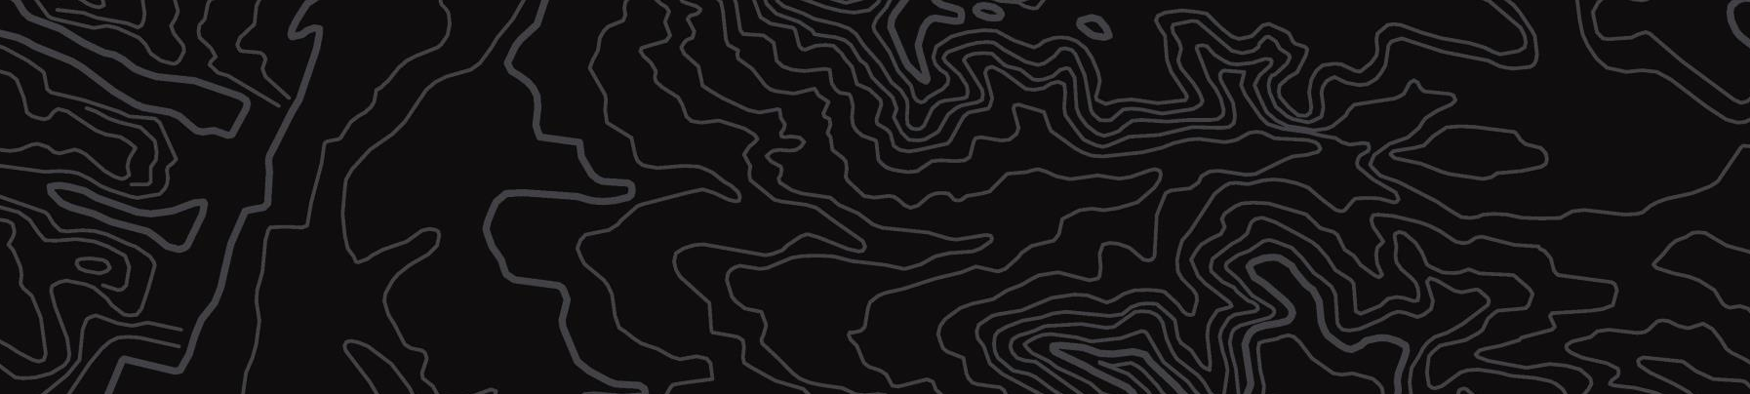

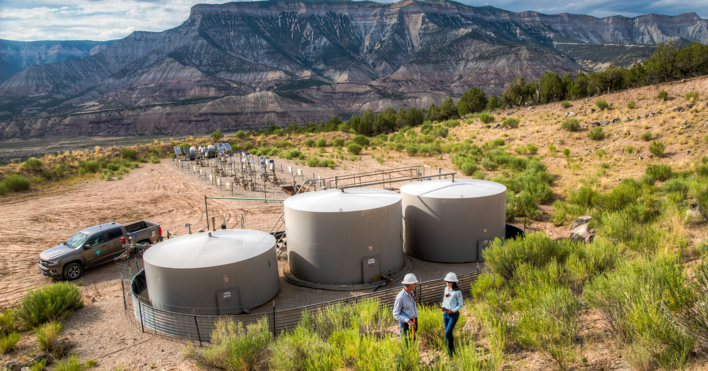
BLM Colorado | Energy
U.S. Department of the Interior
Bureau of Land Management
Overview of energy development on public lands

Slide 2
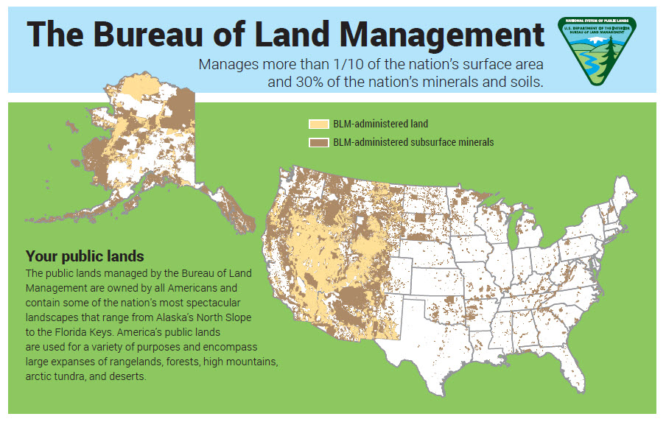
The Bureau of Land Management
An agency under the U.S. Department of the Interior that manages public lands for a variety of uses such as:
energy development
livestock grazing
recreation
timber harvesting
while ensuring natural, cultural, and historic resources are maintained for present and future use.

Slide 3
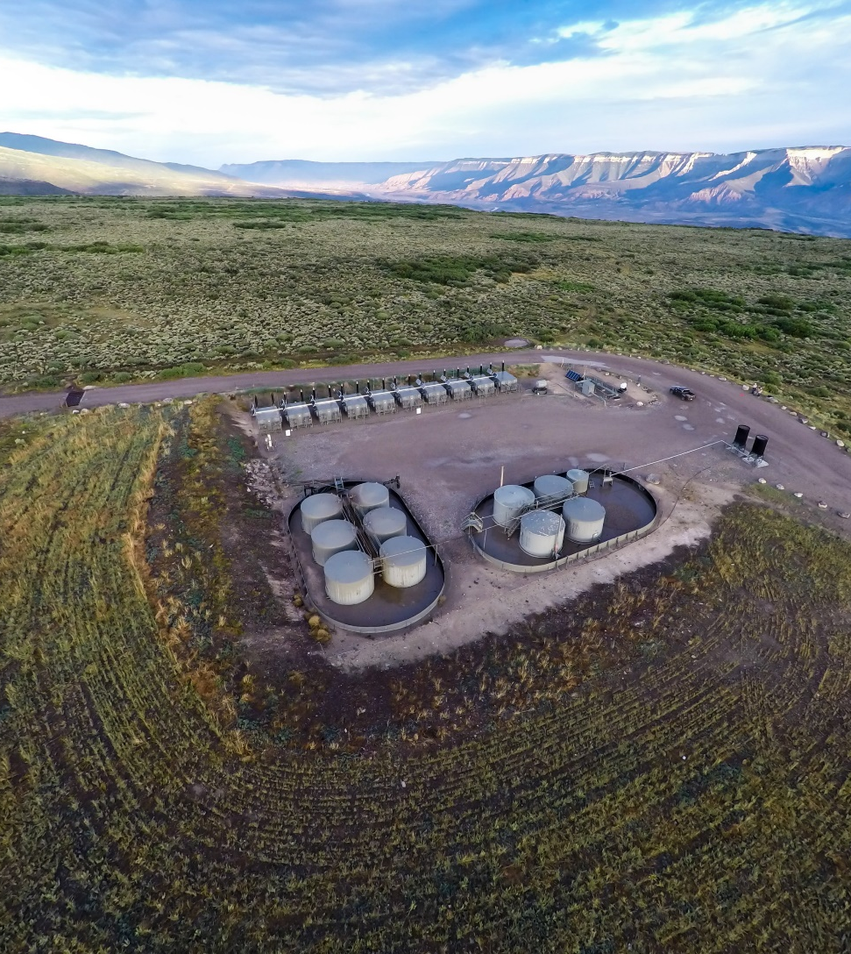
​Colorado's 8.3 million acres of public lands and more than 27 million acres of mineral estate support diverse lifestyles and livelihoods on healthy and working landscapes.
In Colorado, the BLM generates an economic output of over $5.7 billion, which supports nearly 20,000 jobs.
Legislation, like the Federal Land Policy and Management Act, was designed to facilitate production on federal lands.

Slide 4
Expressions of Interest (EOI)
An informal nomination to request certain lands are included in a competitive lease sale.
Submitted via the National Fluids Lease Sale System.

Slide 5
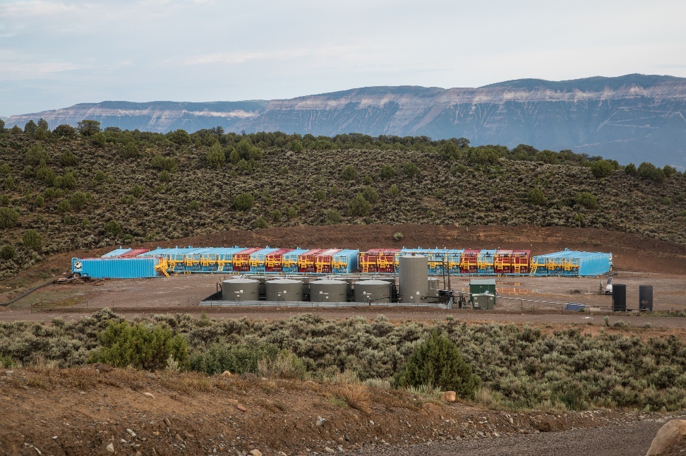
National Environmental Policy Act (NEPA) Compliance
Leasing decisions are analyzed through a land management plan/environmental impact statement to address the cumulative impacts of leasing, exploration and development.

Slide 6
BLM Colorado Lease Sale process
Expressions of Interest
Parcels are provided to field offices to review for conformity with Resource Management Plans and list current lease stipulations
Parcels are posted for public scoping
Analyze comments and prepare preliminary Environmental Assessment/Determination of NEPA Adequacy (EA/DNA)
30-day public comment period
Prepare Final EA/DNA
Sale Notice and 30-Day protest period
Sale is held open to the public at energynet.com.

Slide 7
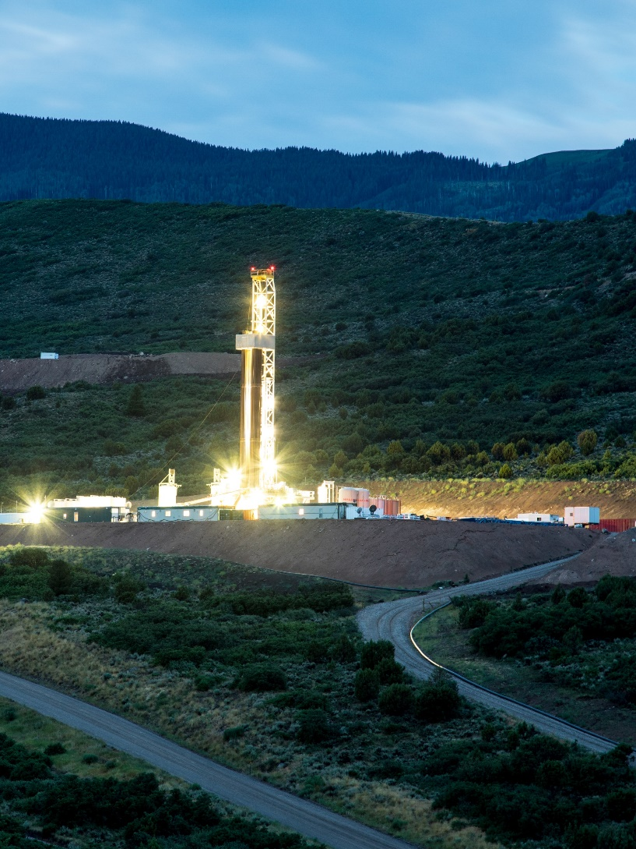
Frequency
BLM Colorado holds lease sales quarterly, as required by the Mineral Leasing Act, when eligible lands are available for leasing.

Slide 8
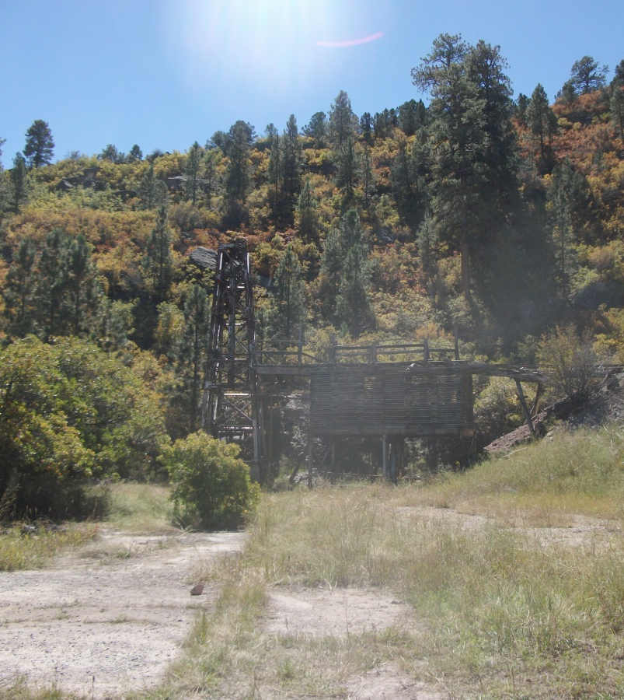
Coal & Mining
The General Mining Act of 1872 is a federal law that authorizes and governs prospecting and mining for economic minerals, such as gold, platinum, and silver, on federal public lands
There are 10 mines for coal in Colorado on authorized federal leases, six are actively operating.
BLM Colorado’s Mining Law Administration Program has 74 active operations — 34 authorized plans of operations and 30 bonded exploration.
BLM Colorado's Non-Energy Leasable Mineral Materials program has eight sodium leases and one oil shale research, development and demonstration lease.

Slide 9
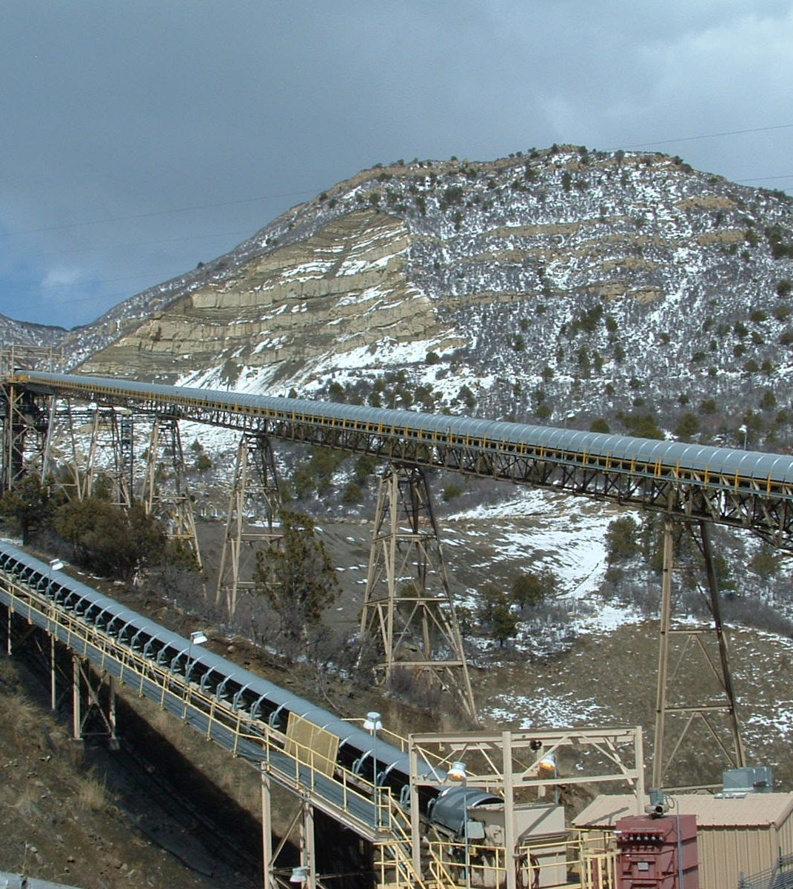
Renewable Energy & Right-of-Way Grants
Rights-of-way (ROW) grants on public lands are authorizations to use public lands in support of infrastructure projects across the country.
Over half (59,000) of the total 118,000 ROW grants the BLM manages are for energy-related infrastructure and facilities. BLM Colorado processes more than 500 applications, amendments and renewals each year.

